Slide 1


Consumer Goods Ad-Hoc Insights
Atliq Hardwares
Presented By
Abdul Basith

Slide 2
Problem Statement
Atliq Hardwares (Imaginary Company) is one of the leading computer hardware producers in India and well expanded in other countries too.
The company struggles to derive actionable insights for decision-making.
A lack of robust data analytics limits their ability to address business challenges effectively.
So, they decided to conduct a SQL challenge to hire someone to expand their data analytics team.

Slide 3

Data Set Overview
The dataset comprises 6 main tables detailing various aspects of Atliq Hardwares' business operations.
Customer Insights: Details customer platforms, sales channels, and regions (dim_customer).
Product Data: Categorizes products by division, segment, and variants (dim_product).
Financial Metrics: Covers gross prices, manufacturing costs, and pre-invoice deductions.
Sales Performance: Tracks monthly sales by product and customer (fact_sales_monthly).
The dataset spans fiscal years 2020 and 2021, facilitating both historical and comparative analysis.

Slide 4
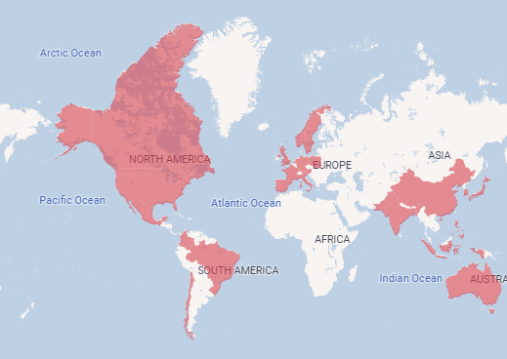
Atliq Hardwares – Market & Customers
Total 74 customers spanned around 27 countries.
Asia Pacific (APAC)
Europe (EU)
North America (NA)
Latin America (LATAM)

Slide 5
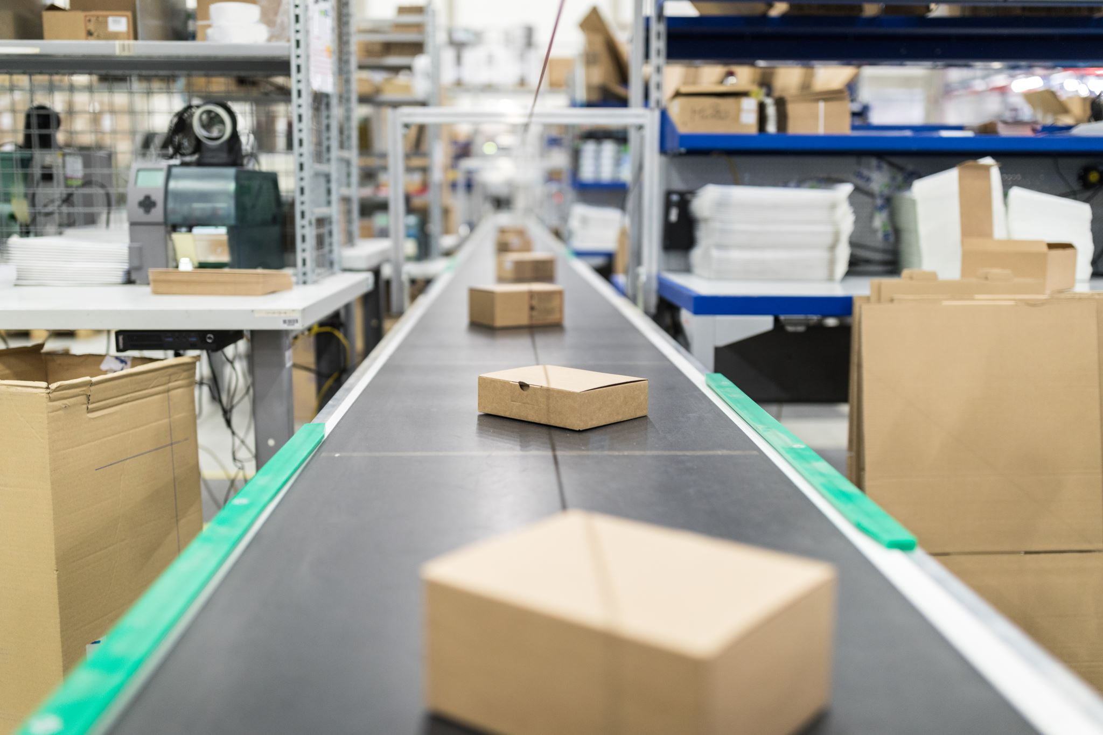
Atliq Hardwares – Market & Customers
Sales Platforms are
Brick & Mortar (Physical store/location)
E-Commerce (Online)
Channels used for distribution are
Retailers (Physical or online stores that sell products to consumers)
Direct (Sales made directly to consumers through a company's website or other direct means)
Distributors (Intermediaries or middlemen between the manufacturer and retailer or end consumers.)

Slide 6

Atliq Hardwares – Products
397 Products ranges in the below segments
Peripherals (keyboard, mouse, monitor, etc.)
Accessories (cases, cooling solutions, power supplies)
Notebook (laptops)
Desktop (desktops, all-in-one PCs, etc.)
Storage (hard disks, SSDs, external storage)
Networking (routers, switches, modems, etc.)
The products categorized into different variants too such as Standard, Plus, Premium that represent different versions of the same product.

Slide 7
Ad-Hoc Requests
To address the challenges, Atliq Hardwares outlined 10 ad-hoc data analysis requests.
These requests aim to provide insights into business operations and support informed decision-making.
The focus is on demonstrating technical proficiency and delivering actionable solutions.
Run a SQL query to answer these requests.

Slide 8

Ad-Hoc Request 1
Provide the list of markets in which customer "Atliq Exclusive" operates its business in the APAC region.
SQL Query

Slide 9
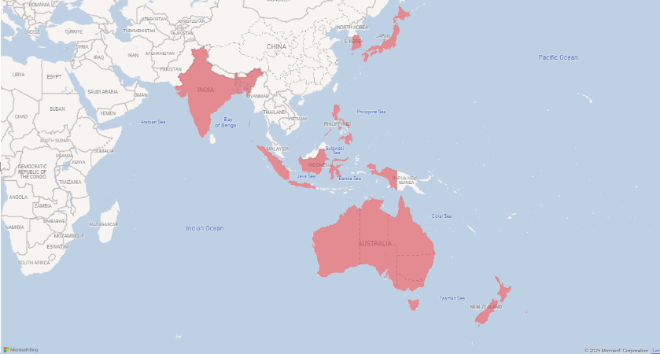
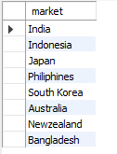
Solution – 1

Slide 10
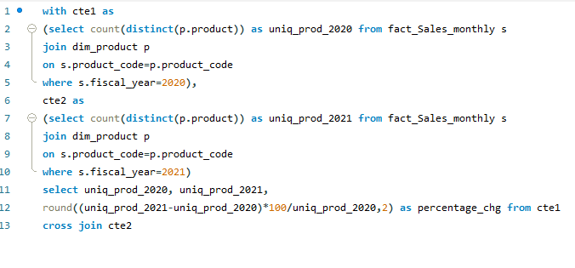
Ad-Hoc Request 2
What is the percentage of unique product increase in 2021 vs. 2020? The final output contains these fields,
unique_products_2020
unique_products_2021
percentage_chg
SQL Query

Slide 11

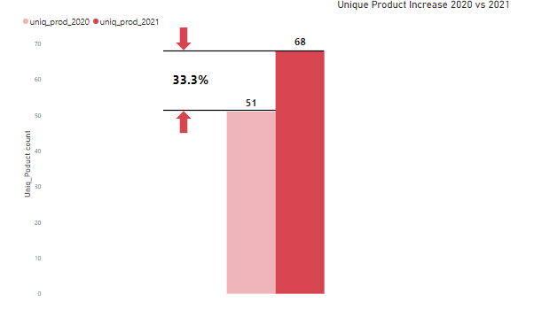
Solution – 2

Slide 12
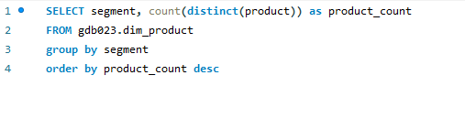
Ad-Hoc Request 3
Provide a report with all the unique product counts for each segment and sort them in descending order of product counts. The final output contains 2 fields,
segment
product_count
SQL Query

Slide 13
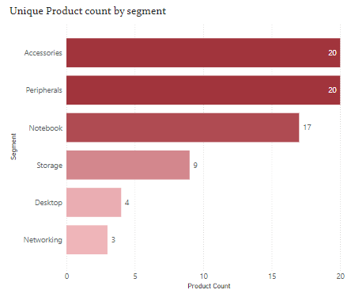
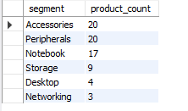
Solution – 3

Slide 14
Ad-Hoc Request 4
Follow-up: Which segment had the most increase in unique products in 2021 vs 2020? The final output contains these fields,
segment
product_count_2020
product_count_2021
difference

Slide 15
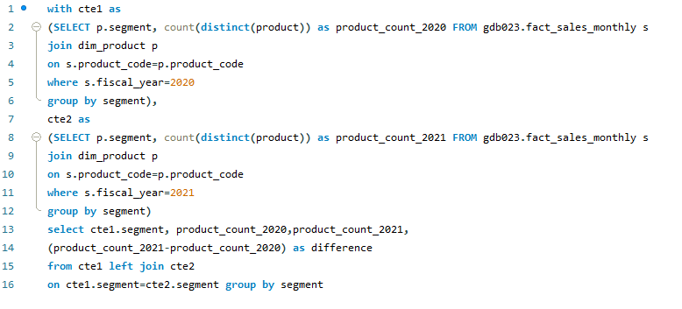
Ad-Hoc Request 4
SQL Query

Slide 16
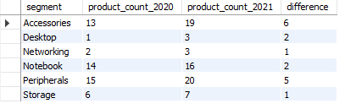
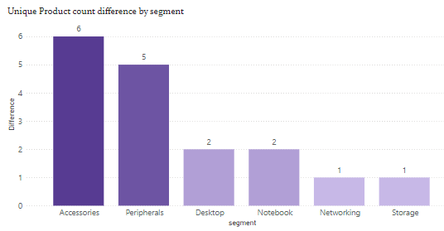
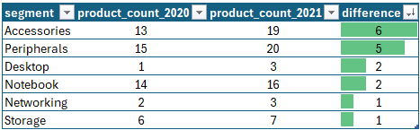
Solution – 4

Slide 17
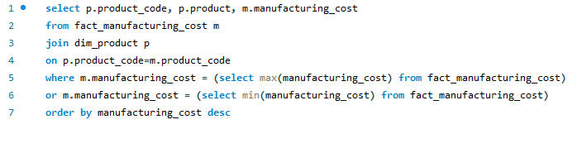
Ad-Hoc Request 5
Get the products that have the highest and lowest manufacturing costs. The final output should contain these fields,
product_code
product
manufacturing_cost
SQL Query

Slide 18

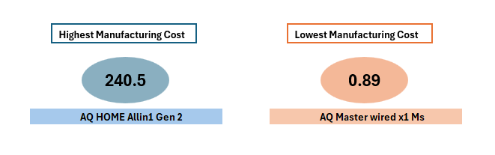
Solution – 5

Slide 19
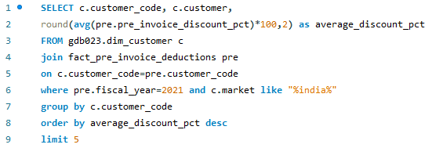
Ad-Hoc Request 6
Generate a report which contains the top 5 customers who received an average high pre_invoice_discount_pct for the fiscal year 2021 and in the Indian market. The final output contains these fields,
customer_code
customer
average_discount_percentage
SQL Query

Slide 20
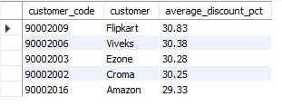
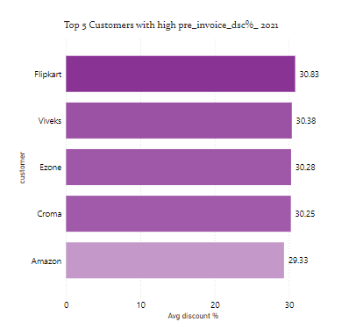
Solution – 6

Slide 21
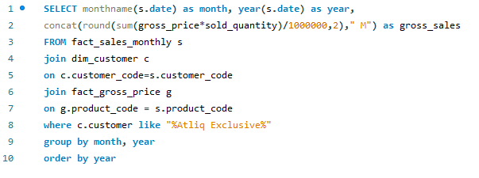
Ad-Hoc Request 7
Get the complete report of the Gross sales amount for the customer “Atliq Exclusive” for each month. This analysis helps to get an idea of low and high-performing months and take strategic decisions. The final report contains these columns:
Month
Year
Gross sales Amount
SQL Query

Slide 22
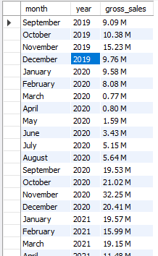
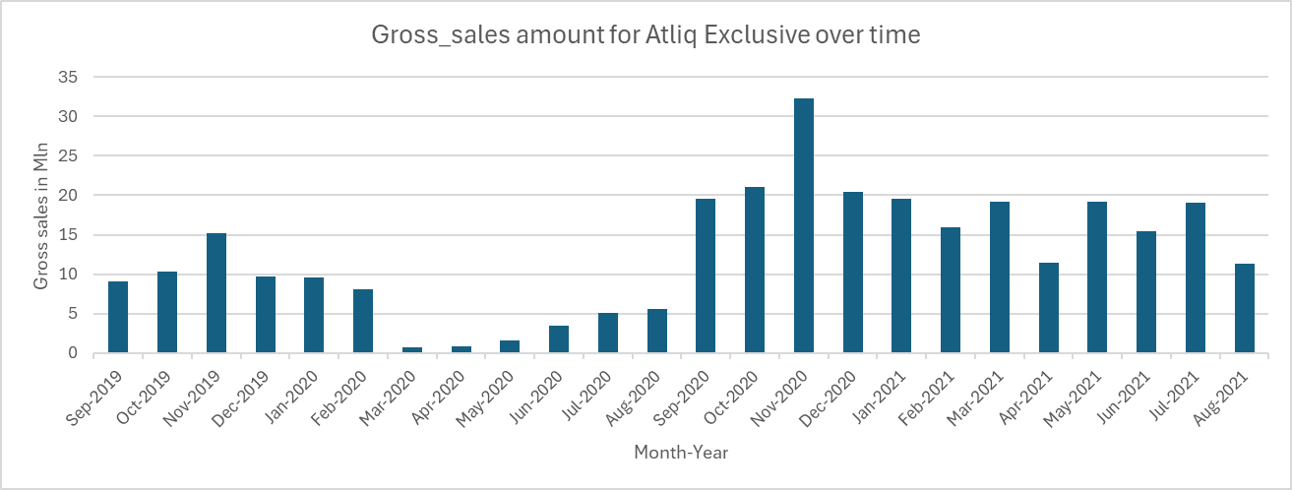
Solution – 7

Slide 23
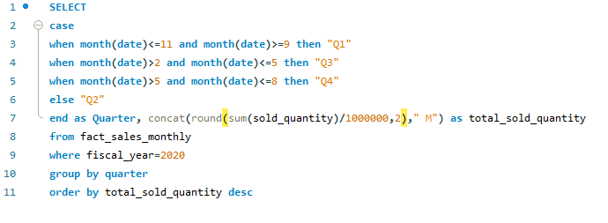
Ad-Hoc Request 8
In which quarter of 2020, got the maximum total_sold_quantity? The final output contains these fields sorted by the total_sold_quantity,
Quarter
total_sold_quantity
SQL Query

Slide 24

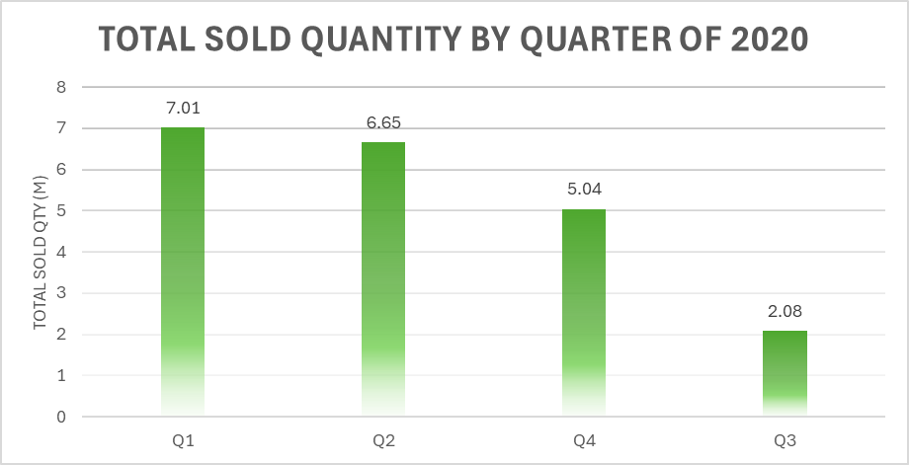
Solution – 8

Slide 25
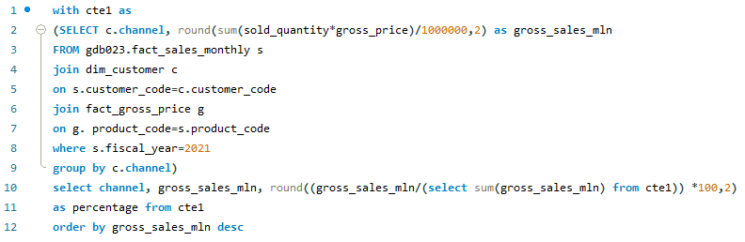
Ad-Hoc Request 9
Which channel helped to bring more gross sales in the fiscal year 2021 and the percentage of contribution? The final output contains these fields,
channel
gross_sales_mln
percentage
SQL Query

Slide 26

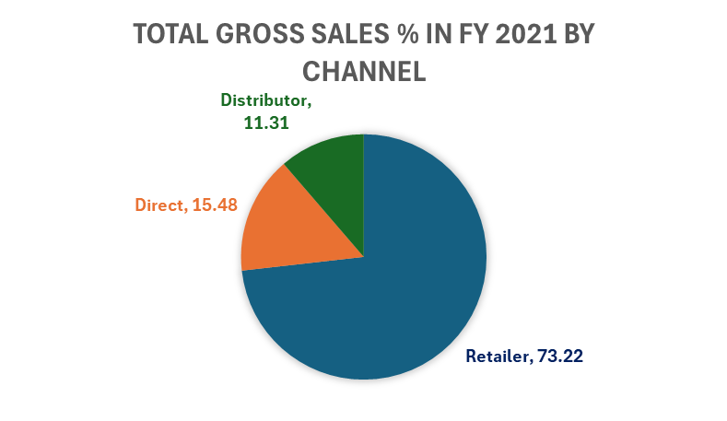
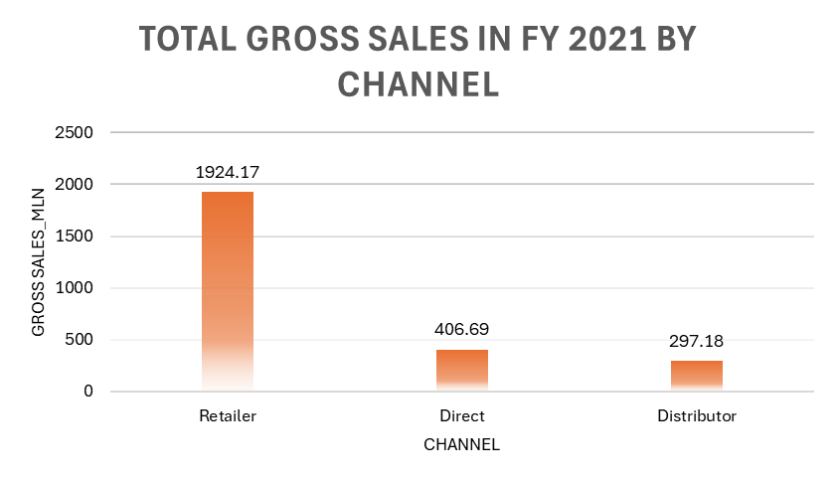
Solution – 9

Slide 27
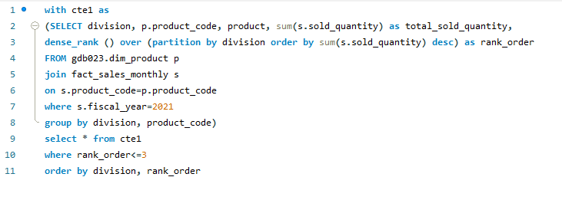
Ad-Hoc Request 10
Get the Top 3 products in each division that have a high total_sold_quantity in the fiscal_year 2021? The final output contains these fields,
division
product_code
SQL Query

Slide 28
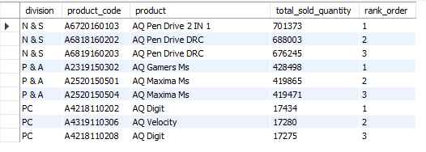
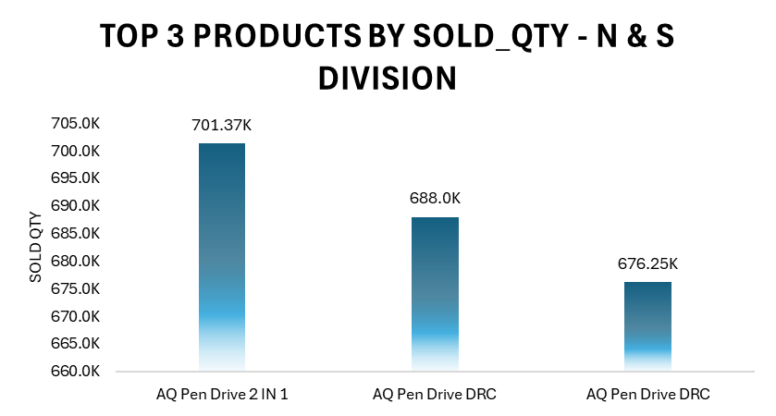
Solution – 10

Slide 29
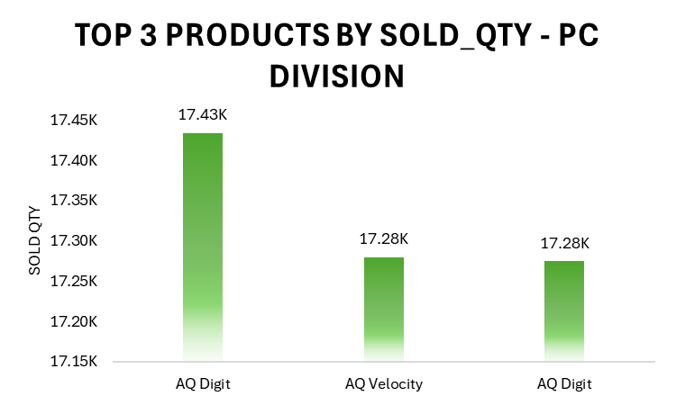
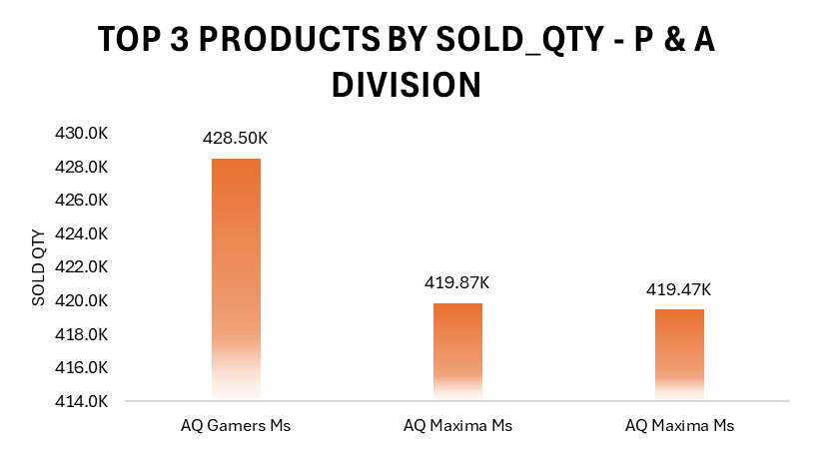
Solution – 10

Slide 30

THANK YOU

